Slide 1
Airbnb Price Prediction
Andy Dai, Zhe Zhou, Loreto Villalba Rubio

Slide 2
Introduction
Provide an analysis of Airbnb, specifically at New York City area
To mine the data and uncover interesting observation about the different hosts and areas
Examine the data, analyze outliers and clean the data
Price variation based on different factors

Slide 3
Data Exploration
Variables in 2019 Airbnb New York City booking data set:
Neighborhood
Host name
ID number
Customer name
Location by Latitude and Longitude.
Room Type
Price difference
Host’s availability
Days stayed and reviews
Preprocess the dataset:
Tested out the “price” and “availability_365” column to find out anomalies
Removed the data that had either of these (N/A or 0) as part of cleaning the data since the price and the number of days when listing is available for booking will not be zero

Slide 4
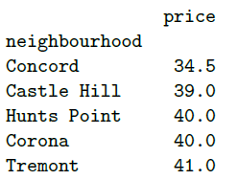
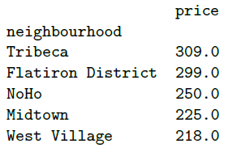
Price vs. Neighborhood
Group the dataset by the column “neighbourhood”
Remove any group that size is less than 5
Filter down to median price in each group
Print out top 5 and bottom 5 neighborhood based on the price of the Airbnb in that neighborhood

Slide 5
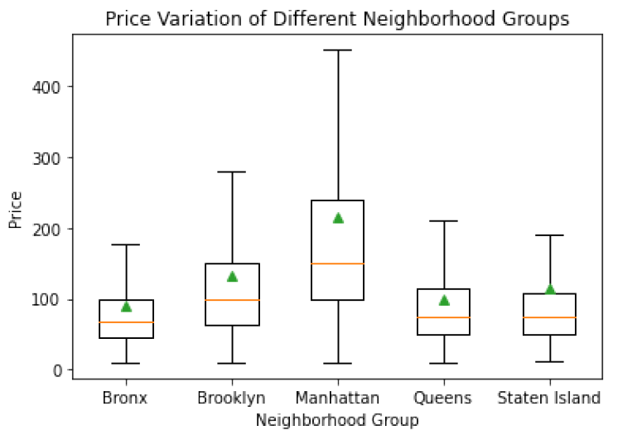
Price vs. Neighborhood
We used boxplot for all neighborhood groups that are created
We eliminated any luxury Airbnb booking which may affect the outcome as outliers
According to the chart, Manhattan has the most expensive Airbnb among all neighborhood groups (also highest median and mean price)
The Airbnb price and price variation will increase in Manhattan

Slide 6
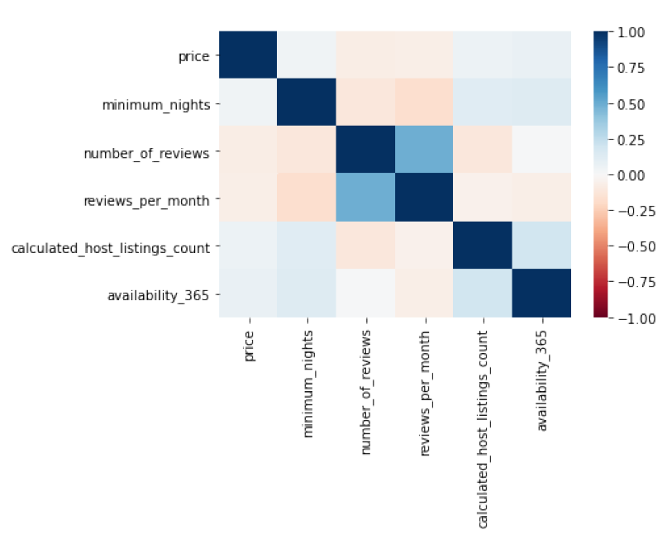
Correlation Analysis
To determine the correlation we created a heat map:
Using “Price”, “Minimum_nights”, “Number of reviews”, “Reviews per month”, “Host listings count” and “Availability_365”
Darker color implies the absolute value of the correlation coefficient is closer to 1 or -1
According to the heatmap, find correlation between “price” and other variables:
the “number of reviews” and “reviews per month” have a negative correlation to “price”
“minimum nights”, “calculated host listings count” and “availability” have a positive correlation to “price”

Slide 7
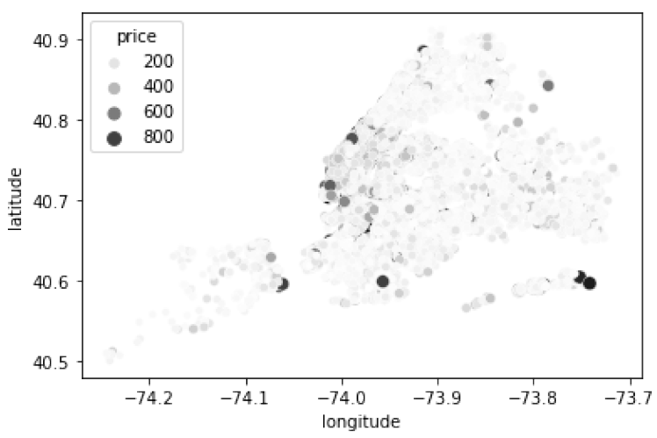
Price vs. Longitude & Latitude
We want to figure out the association between longitude & latitude and price:
Remove any data whose price is greater or equal to $1000
Create a scatter plot where x value is the column "longitude", and the y value is the column "latitude"
The color and size of the points bases the value of "price" (The higher the price, darker the point will be)
According to the scatter plot, we can figure out in which neighborhood groups price will be higher:
Manhattan has the most expensive booking among all neighborhood groups

Slide 8
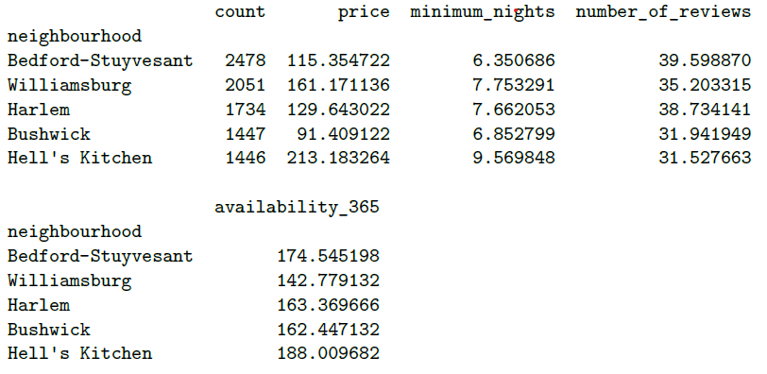
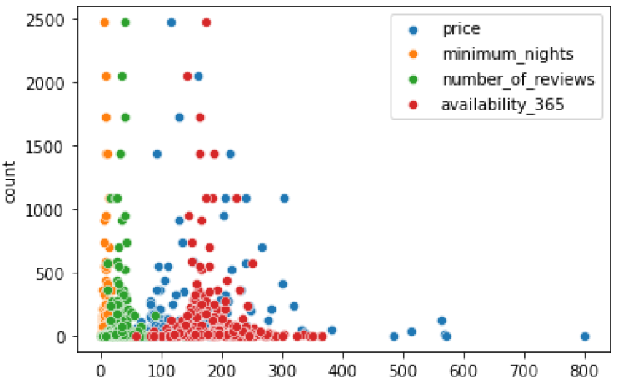
Busiest Area
We also want to consider whether the busiest area will have impact or relation on neighborhood pricing:
We found that there’s no linear relationship between price, min nights, number of reviews and availability using the scatter plot
If the price of an area is higher, more hosts want to make listings there. Also, more reviews imply a higher number of customers
From the data, Bedford-Stuyvesant is the busiest area cause it has the highest number of listings. With Average price of $115.35 and mean # of reviews of 40

Slide 9
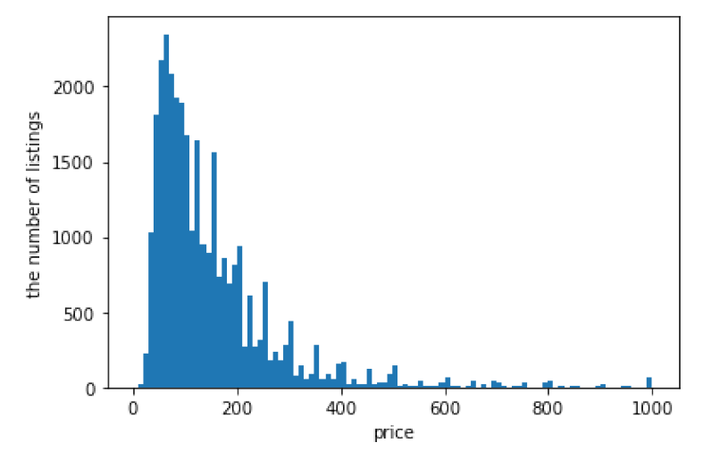
Interesting Finding
According to the data, prices of most listings are between $0 and $200, with a very small proportion of all listings in the dataset will have their price of more than $200

Slide 10
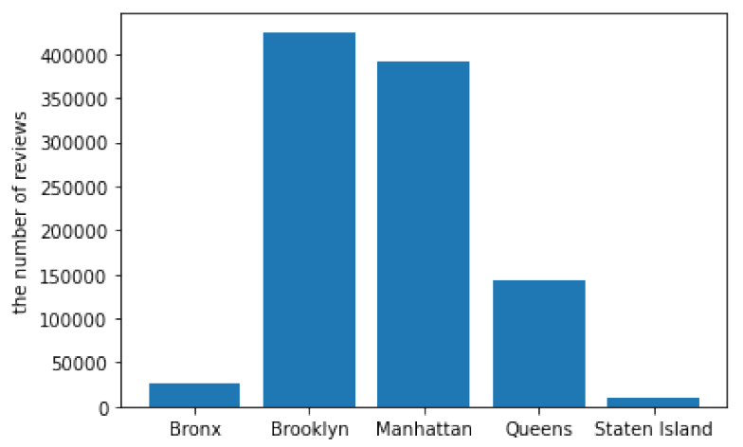
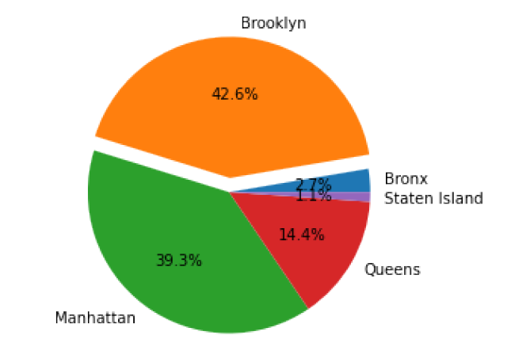
Interesting Finding
According to the data “the number of reviews”, Brooklyn has the highest number of reviews, with Manhattan right behind it at 39.3% of the market share in NYC

Slide 11
Classification of Airbnb Price Prediction
In this part, we decide to build a random forest regression model to do the classification of Airbnb Price Prediction
Package and Function used in Python:
“DecisionTreeClassifier( )” in sklearn.tree
Variables used to fit the regression model (selected from previous analysis):
“price”
"latitude"
"longitude"
"room_type"
"reviews_per_month"
"calculated_host_listings_count"
"availability_365"
Since some variables are categorical, we need to convert them into numeric values before fitting the random forest regression model
For “price”, according to mean value in “price” variable, we decide to separate it into 3 types:
low (0): less than $100
medium (1): between $100 and $200
high (2): above $200
In the random forest model, we don’t need to consider if a categorical variable is nominal or ordinal. However, the function require numeric input, so we need to use numeric values to represent each type in categorical variables.
For “room_type”, use 0 to represent shared room, 1 to represent private room, and 2 to represent entire home/apt.

Slide 12
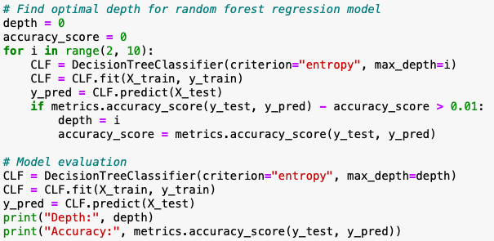

For the random forest regression model, we need to decide the value of depth. The goal is to maximum the accuracy and make depth as small as possible.
The algorithm on the right side fit the model by different values of depth from 2 to 10, and pick the depth that has a significant effect on the accuracy of the regression model.
So, if the accuracy of the model increase 0.01, we will consider this increase as significant.
In the end, the algorithm tells the best depth is 6, and the accuracy of the model is 58.92%
Python Codes & Results

Slide 13
Regression of Airbnb Price Prediction
Package and Function used in Python:
“LinearRegression( )” in sklearn.linear_model
Variables used to fit the linear regression model (selected from previous analysis):
“price”
"neighbourhood_group"
"room_type"
"minimum_nights"
"number_of_reviews"
"reviews_per_month"
"calculated_host_listings_count"
"availability_365"
Since some variables are categorical, we need to convert them into numeric values before fitting the linear regression model
For "neighbourhood_group", since it’s a nominal variable, so it cannot be converted to numeric values directly. We replace it by four variables “Brooklyn”, “Manhattan”, “Queens”, and “Bronx”, and let 1 represents “Yes”, 0 represents “No”. Note that, all 0 represents “Staten Island”.
For “room_type”, we consider it as a ordinal variable, so we can convert it to numeric values directly. We use 0 to represent shared room, 1 to represent private room, and 2 to represent entire home/apt.

Slide 14
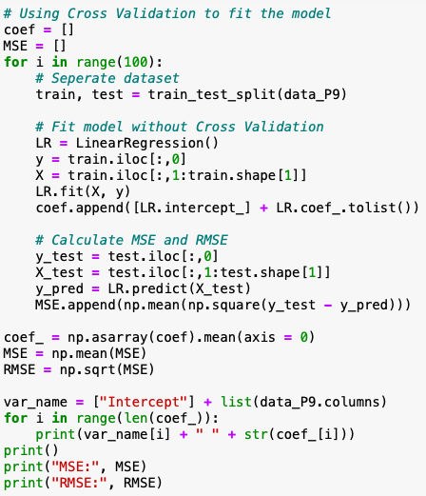
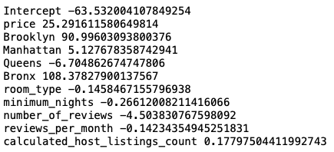
Below is the coefficients of the fitted multiple linear regression model:
Mean Square Error (MSE) for this linear regression is 58517.31; Root Mean Square Error (RMSE) for this linear regression is 242.90
Python Codes & Results

Slide 15
Discussion
RMSE of the linear regression model is around 250, so errors will be large when using this model to predict the price
Not perform detailed variable analysis before fitting the model, so some variables may not very significant to price
Not consider the interaction between different variables
For classification, classifying randomly will make a 33% accurate prediction, so the accuracy of the random forest regression model may not be acceptable
Only do classification and regression on price, clustering may be a better approach method
Deficiency in the classification and regression of Airbnb price prediction

Slide 16
Thank You !

